Slide 1
Software Quality Assurance
By Engr. Shumail zehra

Slide 2
Outcome of this course
Upon successful completion of this course, you will accomplish the following objectives and outcomes.
To discover and learn various concepts and techniques related to software quality assurance
To learn to apply these techniques
To develop critical thinking skills
Defining quality assurance plans
Applying quality assurance tools & techniques, etc.

Slide 3
Reference Material/Books
Software Quality Assurance From Theory to Implementation.pdf
By DANIEL GALIN
Software Testing _ Quality Assurance - Theory and Practice.pdf
By KSHIRASAGAR NAIK

Slide 4
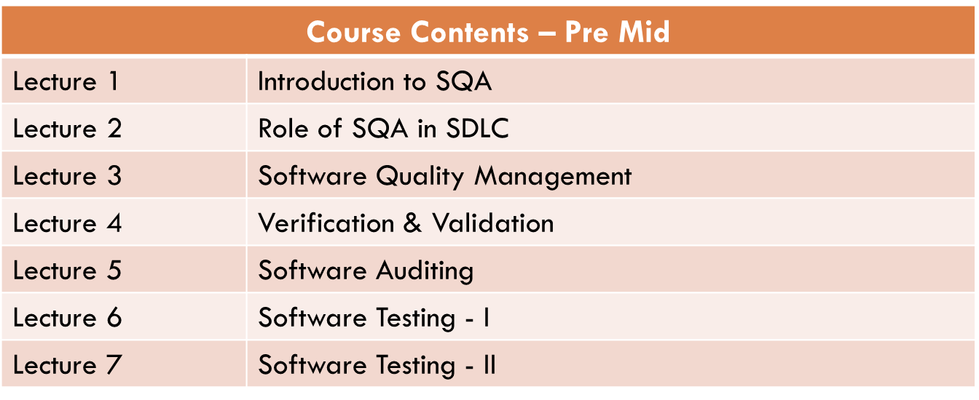
Course Outline

Slide 5
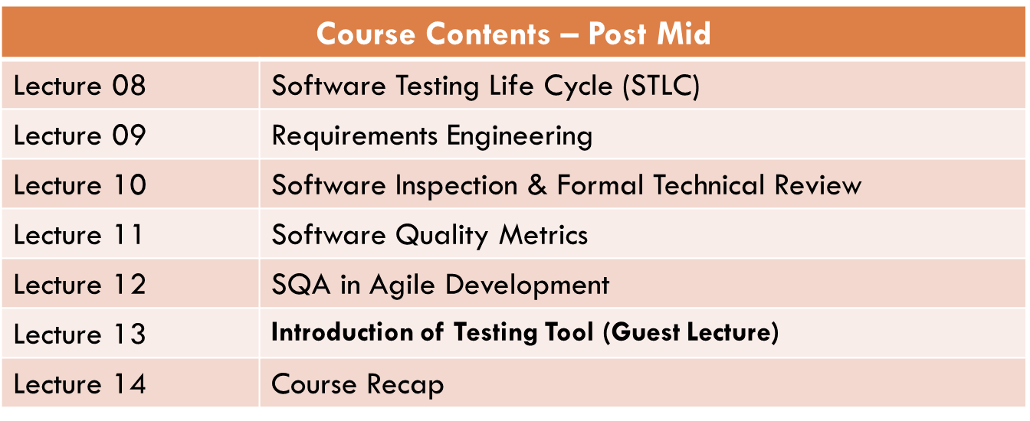
Course Outline (Cont….)

Slide 6
What is Software?
Software is:
“Software, in its most general sense, is a set of instructions or programs instructing a computer to do specific tasks.
Software is a generic term used to describe computer programs. Scripts, applications, programs and a set of instructions are all terms often used to describe software

Slide 7
What is Quality ?
Common definition for Quality:
The standard of something as measured against other things of a similar kind; the degree of excellence of something.
Quality in terms of Organization:
Quality is about making organizations perform for their stakeholders – from improving products, services, systems and processes, to making sure that the whole organization is fit and effective.

Slide 8
What is Software Quality?
Quality software is reasonably bug or defect free, delivered on time and within budget, meets requirements and/or expectations, and is maintainable
² Achieving high levels of user satisfaction, portability, maintainability, and fitness for use”

Slide 9
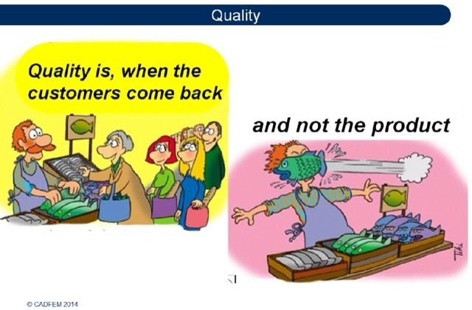

Slide 10
Why Quality is Important?
^{λ} Quality is critical for survival and success.
^{λ} Customers demand quality..
^{λ} Everybody wants quality
^{λ} Essentially quality means satisfying customer.

Slide 11
Why Quality is Important?
–
–
–
–
Quality gives you the global reach Quality is cost effective
Quality helps retain customers and increase profits

Slide 12
Software Quality Factors
This model classifies all software requirements into 11 software quality factors. The 11 factors are grouped into three categories – product operation, product revision, and product transition factors.
Product operation factors − Correctness, Reliability, Efficiency, Integrity, Usability.
Product revision factors − Maintainability, Flexibility, Testability.
Product transition factors − Portability, Reusability, Interoperability.

Slide 13
Product Operation Software Quality Factors
Correctness
These requirements deal with the correctness of the output of the software system. They include −
The required accuracy of output that can be negatively affected by inaccurate data or inaccurate calculations.
The completeness of the output information, which can be affected by incomplete data.
The up-to-dateness of the information defined as the time between the event and the response by the software system.
The availability of the information.

Slide 14
Product Operation Software Quality Factors
Reliability
Reliability requirements deal with service failure. They determine the maximum allowed failure rate of the software system, and can refer to the entire system or to one or more of its separate functions.
Efficiency
It deals with the hardware resources needed to perform the different functions of the software system. It includes processing capabilities (given in MHz), its storage capacity (given in MB or GB) and the data communication capability (given in MBPS or GBPS).

Slide 15
Product Operation Software Quality Factors
Integrity
This factor deals with the software system security, that is, to prevent access to unauthorized persons, also to distinguish between the group of people to be given read as well as write permit.
Usability
Usability requirements deal with the staff resources needed to train a new employee and to operate the software system.

Slide 16
Product Revision Quality Factors
Maintainability
This factor considers the efforts that will be needed by users and maintenance personnel to identify the reasons for software failures, to correct the failures, and to verify the success of the corrections.
Flexibility
This factor deals with the capabilities and efforts required to support adaptive maintenance activities of the software. These include adapting the current software to additional circumstances and customers without changing the software.

Slide 17
Product Revision Quality Factors
Testability
Testability requirements deal with the testing of the software system as well as with its operation. It includes predefined intermediate results, log files, and also the automatic diagnostics performed by the software system prior to starting the system, to find out whether all components of the system are in working order and to obtain a report about the detected faults. Another type of these requirements deals with automatic diagnostic checks applied by the maintenance technicians to detect the causes of software failures.

Slide 18
Product Transition Software Quality Factor
Portability
Portability requirements tend to the adaptation of a software system to other environments consisting of different hardware, different operating systems, and so forth. The software should be possible to continue using the same basic software in diverse situations.
Reusability
This factor deals with the use of software modules originally designed for one project in a new software project currently being developed. The reuse of software is expected to save development resources, shorten the development period, and provide higher quality modules.

Slide 19
Product Transition Software Quality Factor
Interoperability
Interoperability requirements focus on creating interfaces with other software systems or with other equipment firmware. For example, the firmware of the production machinery and testing equipment interfaces with the production control software.

Slide 20
Software Quality Challenges
^{λ} The measures for quality differ from project to project and organization to organization
Quality measures used for small systems may not be appropriate for the large ones.
^{λ} Criteria for quality vary as a function of the specific characteristics of the project, the needs of the users and stakeholders, and the application requirements of the system and software.
–
.

Slide 21
What is Software Quality Assurance?
Software quality assurance is
The maintenance of a desired level of quality in a service or product, especially by means of attention to every stage of the process of delivery or production.
Software quality assurance (SQA) is a process that ensures that developed software meets and complies with defined or standardized quality specifications.
.

Slide 22
Three General Principles of QA
^{λ} Know what you are doing
^{λ} Know what you should be doing
^{λ} Know how to measure the difference

Slide 23
Three General Principles of QA
Know what you are doing
^{λ} understand what is being built, how it is being built and what it currently does.

Slide 24
Three General Principles of QA
^{λ} Know what you should be doing
–
–
having explicit requirements and specifications
suppose a software development process with
^{λ} requirements analysis,
^{λ} acceptance tests,
^{λ} frequent user feedback

Slide 25
Three General Principles of QA
^{λ} Know how to measure the difference
– having explicit measures comparing what is being done from what should be done
–

Slide 26
Software Quality Challenges
^{λ} Complex Software requires different monitoring procedures than trivial applications.
^{λ} Quality criteria vary dramatically depending on the phase of the project at which the evaluation takes place
^{λ} The measures of the quality must be specific to the project being evaluated and must assess the effectiveness of the entire development process, not just individual segments.

Slide 27
Software Quality Challenges
Quality cannot be directly checked in the product; it must planned right from the beginning.
Quality goals must be clearly defined, effectively monitored, and rigorously enforced.
The project must focus on the quality issues of the project from the beginning, ensuring that quality criteria are consistent with defined requirements.

Slide 28
Changing View of Quality
Past
Quality is the responsibility employees working on the product
Quality defects should be hidden from the customers and management
Quality problems lead to blame, faulty justification and excuses
Corrections-to-quality problems should be accompanied with minimum documentation
Present
Quality is everyone’s responsibility, including, the indirect labor force and the overhead staff
Defects should be highlighted and brought to the surface for corrective actions
Quality problems lead to cooperative solutions
Documentation is essential for “lessons learnt” so the mistakes are not repeated.

Slide 29
Changing View of Quality
Past
Increased quality will increase project costs
Quality is internally focused
Quality occurs during project execution
Present
Improved quality saves money and increase business
Quality is customer focused
Quality occurs at project initiation and must be planned for within the project

Slide 30
Quality Control v/s Quality Assurance
Quality means meeting requirements and meeting customer needs, which means a defect-free product from both the producer’s and the customer’s viewpoint.
Both quality control and quality assurance are used to make quality happen.
Quality is an attribute of a product. A product is something produced, such as a requirement document, test data, source code etc.

Slide 31
Quality Control v/s Quality Assurance
Quality Assurance
Quality Assurance (QA) is the set of activities (including facilitation, training, measurement and analysis) needed to provide adequate confidence that processes are established and continuously improved in order to produce products or services that conform to requirements and are fit for use.
Quality Control
Quality Control (QC) is defined as the processes and methods used to compare product quality to requirements and applicable standards, and the action taken when a nonconformance is detected.

Slide 32
Quality Control v/s Quality Assurance
Quality Assurance QA is an activity that
establishes and evaluates the processes that produce the products. If there is no process, there is no role for QA.
Quality Control
QC is an activity that verifies whether or not the product produced meets standards.

Slide 33
Quality Control v/s Quality Assurance
Quality Control
QC relates to a specific product or service
QC verified whether particular attributes exist, or do not exist, in a specific product or service
QC identifies defect for the primary purpose of correcting defects.
Quality Assurance
QA helps establish processes
QA sets up measurement programs to evaluate processes
QA identifies weakness in processes and improves them

Slide 34
Quality Control v/s Quality Assurance
Quality Assurance QA is a management
responsibility, frequently
performed by a staff function
Quality Control
QC is the responsibility of the worker

